Slide 1

AI-POWERED MULTIMODAL E-COMMERCE SEARCH SYSTEM USING FAISS AND HYBRID RETRIEVAL
  By
  MANGIPUDI SANYASI RAO
  Enroll. No. TU6243204211024
  MCA(DS)-II
Under the Guidance of
Ms.V. KIRUTHIGA MCA., M.Phil., Ph.D.,
Assistant Professor,
School of Computer Science

Slide 2
INTRODUCTION
E-commerce platforms contain a large and diverse collection of products
Users often face difficulty in finding relevant products quickly
Traditional search systems rely mainly on keyword matching techniques
These systems fail to understand the actual intent behind user queries
This leads to irrelevant results and poor user satisfaction
AI-based systems provide semantic understanding and intelligent recommendations

Slide 3
OBJECTIVE OF THE PROJECT
Develop semantic search using transformer-based embeddings.
Implement image-based retrieval using deep learning (OpenCLIP).
Design a hybrid ranking mechanism (Text + Visual).
Utilize FAISS for efficient vector similarity search.
Integrate an LLM (Phi-3) for explainable recommendations.
Support multilingual and voice-based queries.

Slide 4
SCOPE OF THE PROJECT
Included:
Processing structured product data.
Generating embeddings for text and images.
Vector-based similarity search using FAISS.
Hybrid ranking & LLM explanation generation.
Responsive web-based UI with chatbot.
Boundary: Designed for scalability but tested on a moderate-sized dataset.

Slide 5
LITERATURE SURVEY & RESEARCH GAP
Author(s) | Year | Contribution | Limitation / Gap
Reimers & Gurevych (Sentence-BERT) | 2019 | Semantic sentence embeddings for similarity search | Text-only; no visual understanding
Radford et al. (CLIP) | 2021 | Multimodal (text + image) shared embedding space | Retrieval not optimized for e-commerce scale
Johnson et al. (FAISS) | 2017 | Efficient similarity search for dense vectors | No ranking or explanation generation
Rusum & Anasuri (Vector Databases) | 2024 | Real-time search & RAG pipelines | Lacks hybrid retrieval + LLM explainability
Ali, O. (RAG) | 2025 | Retrieval-augmented generation for databases | No integration with multimodal e-commerce search

Slide 6
RESEARCH GAP IDENTIFIED
Gap | Description
1. No Unified Multimodal System | Existing systems handle text OR image, not both together
2. No Hybrid Ranking | Semantic search lacks keyword boosting; exact matches ignored
3. No Explainability | Search results are shown without reasoning or justification
4. No RAG for E-commerce | LLMs are not integrated with product retrieval for explanations

Slide 7
HOW PROPOSED SYSTEM ADDRESSES THESE GAPS
Research Gap | Proposed System Solution
Multimodal missing | Text + Image search using Sentence Transformers + OpenCLIP
Poor ranking | Hybrid Ranking (Semantic + Keyword + Filters)
No explainability | LLM (Phi-3) generates factual product explanations
No RAG integration | RAG-inspired pipeline retrieves products → LLM explains

Slide 8
TECHNOLOGIES USED
Programming: Python, FastAPI (Backend), HTML/CSS/JS (Frontend).
NLP: Sentence Transformers (BAAI/bge-small-en-v1.5).
Computer Vision: OpenCLIP (ViT-B/32).
Vector Search: FAISS (Facebook AI Similarity Search).
LLM: Phi-3 (via Ollama).
Multilingual: Langdetect, Deep Translator.

Slide 9
EXISTING SYSTEM (LIMITATIONS)
Keyword Dependency: Fails on synonyms (e.g., "affordable" vs. "cheap").
No Visual Search: Cannot find products by image similarity.
Poor Ranking: Results lack semantic relevance.
No Explainability: Users don't know why a product was recommended.

Slide 10
PROPOSED SYSTEM METHODOLOGY (ARCHITECTURE OVERVIEW)
Input Layer: Text, Voice, Image, Multilingual.
Processing Layer: Sentence Transformers / OpenCLIP -> FAISS Index.
Ranking Layer: Hybrid Scoring (Semantic + Keyword + Filters).
Generation Layer: LLM (Phi-3) for Explanations.
Output Layer: Ranked products with descriptions.

Slide 11
DATA DESIGN & DATASET ENGINEERING
Source: Merged multiple public datasets (Fashion, Electronics).
Size: Unified structured format.
Key Attributes: Title, Description, Price, Category, Image Path.
Engineered Feature: search_text (Combined title+desc+tags for better embeddings).
Preprocessing: Cleaning, deduplication, standardization.

Slide 12
EMBEDDING GENERATION (TEXT & IMAGE)
Text Embeddings:
Model: BAAI/bge-small-en-v1.5.
Output: 384/768-dim vectors capturing semantic meaning.
Image Embeddings:
Model: OpenCLIP (ViT-B/32).
Output: Visual feature vectors (color, shape, texture).
Optimization: GPU acceleration reduced time from 5-6 hours to minutes.

Slide 13
FAISS Index Construction
Why FAISS? Enables Approximate Nearest Neighbor (ANN) search for millions of vectors in milliseconds.
Implementation:
Index 1: Text FAISS Index (Semantic search).
Index 2: Image FAISS Index (Visual similarity).
Storage: Binary (.bin) files for persistence.
Mapping: Index positions mapped to Product IDs

Slide 14
HYBRID RETRIEVAL MECHANISM
Limitation of Single Method: Semantic search might miss exact keywords.
Formula:
Final Score = (w1 * Semantic Similarity) + (w2 * Keyword Boost)
Process:
Retrieve candidates via FAISS.
Re-rank using hybrid scoring.
Apply attribute filters (Price, Category).
Outcome: Highly relevant and precisely matched results.

Slide 15
LLM INTEGRATION FOR EXPLAINABILITY (RAG)
Problem: LLMs hallucinate.
Solution: Retrieval-Augmented Generation (RAG) approach.
Workflow:
1. Retrieve product data (FAISS).
2. Feed data as context to LLM (Phi-3).
3. Generate factual, concise explanation.
Example: "This product is recommended because it matches your query for 'red shoes' and has a 4.8 rating."

Slide 16
MULTILINGUAL & VOICE PROCESSING
Multilingual:
Detect language (Langdetect).
Translate to English (GoogleTranslator).
Process query normally.
Supported: Hindi, Tamil, Telugu, etc.
Voice Search:
Browser Speech Recognition API.
Convert speech -> text -> search.

Slide 17
IMPLEMENTATION (BACKEND - FASTAPI)
Framework: FastAPI (Async, high-performance).
Key Endpoints:
GET /search?query= -> Text search.
POST /image-search -> Image upload search.
GET /chat?msg= -> Chatbot response.
Middleware: CORS for frontend-backend communication.
Response: JSON containing products, scores, and explanations.

Slide 18
IMPLEMENTATION (FRONTEND - UI/UX)
Technologies: HTML5, CSS3, JavaScript.
Key Features:
Semantic search bar.
Image upload widget.
Voice input button.
Dark mode toggle.
Shopping cart.
Chatbot assistant.

Slide 19
SYSTEM TESTING APPROACH
Functional Testing: Validated text, image, voice, multilingual search.
Accuracy Testing: Used Precision@K metric.
Performance Testing: Measured embedding generation & retrieval latency.
Edge Case Testing: Empty queries, invalid images, missing data.

Slide 20
TEST RESULTS (PRECISION@K)
Query | K Value | Relevant Results | Precision@K
"red shoes" | 5 | 4 | 0.8
"wireless headphones" | 5 | 4 | 0.8
"sports shoes" | 5 | 5 | 1.0
"black jacket" | 5 | 3 | 0.6
Analysis: High accuracy for specific queries; scope to improve ambiguous terms.

Slide 21
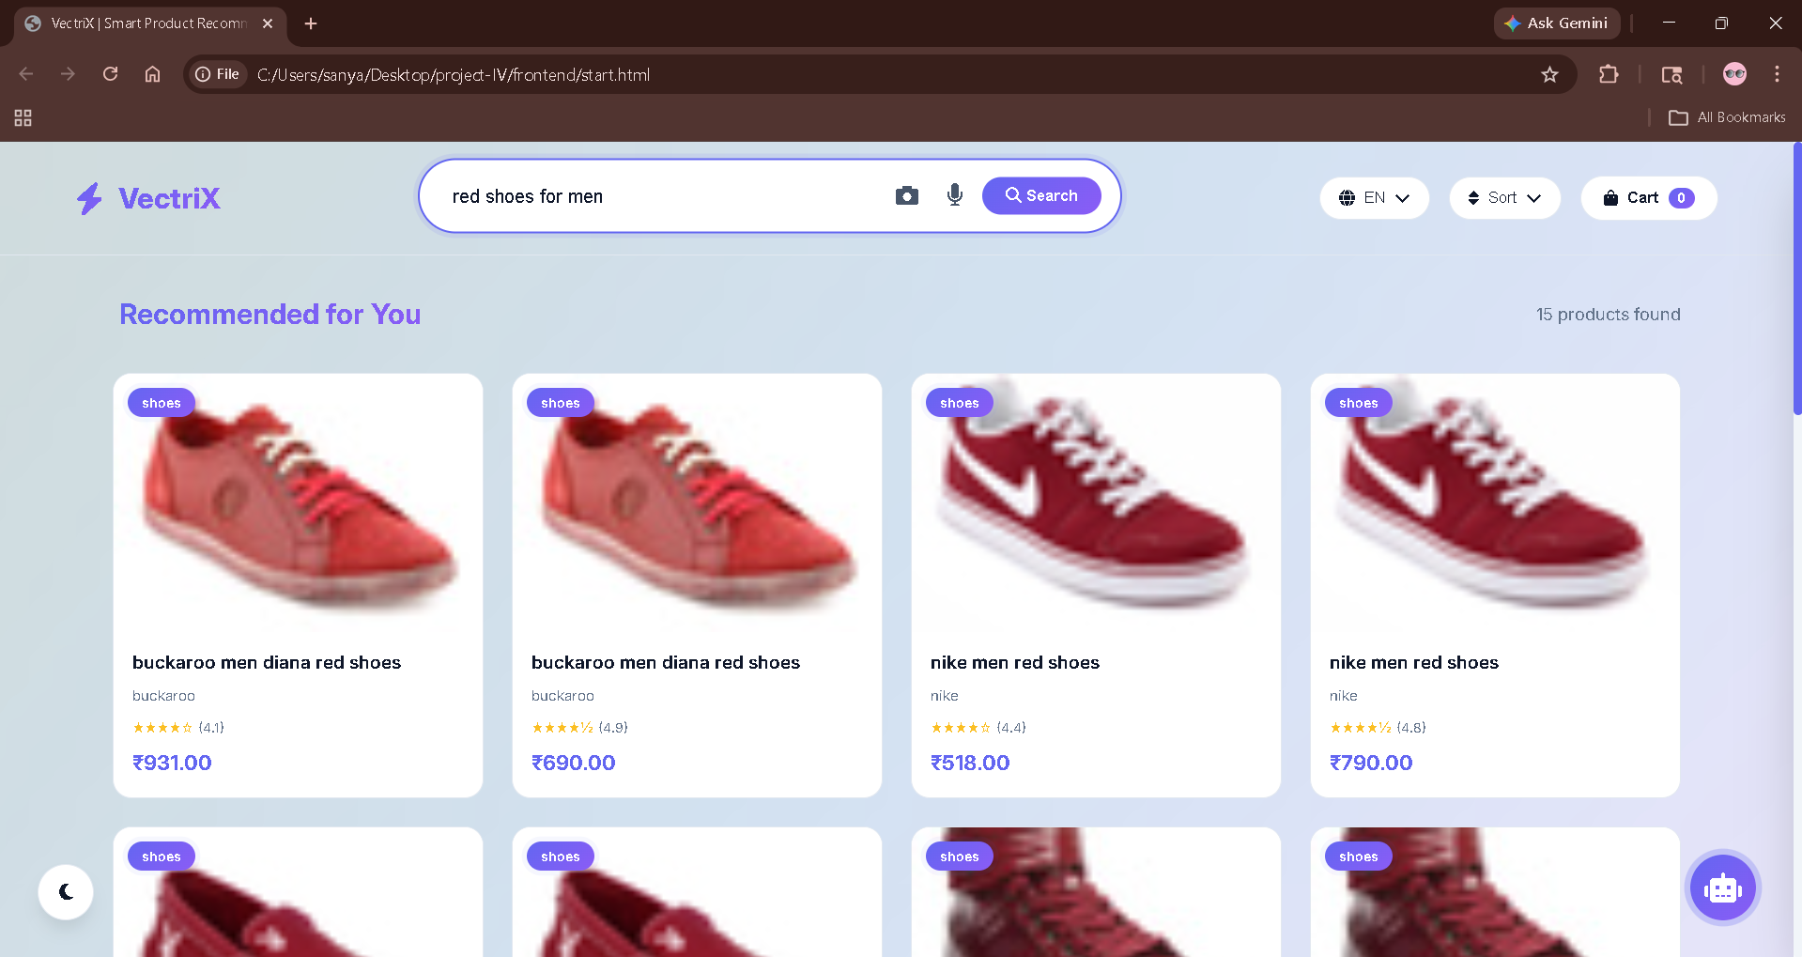
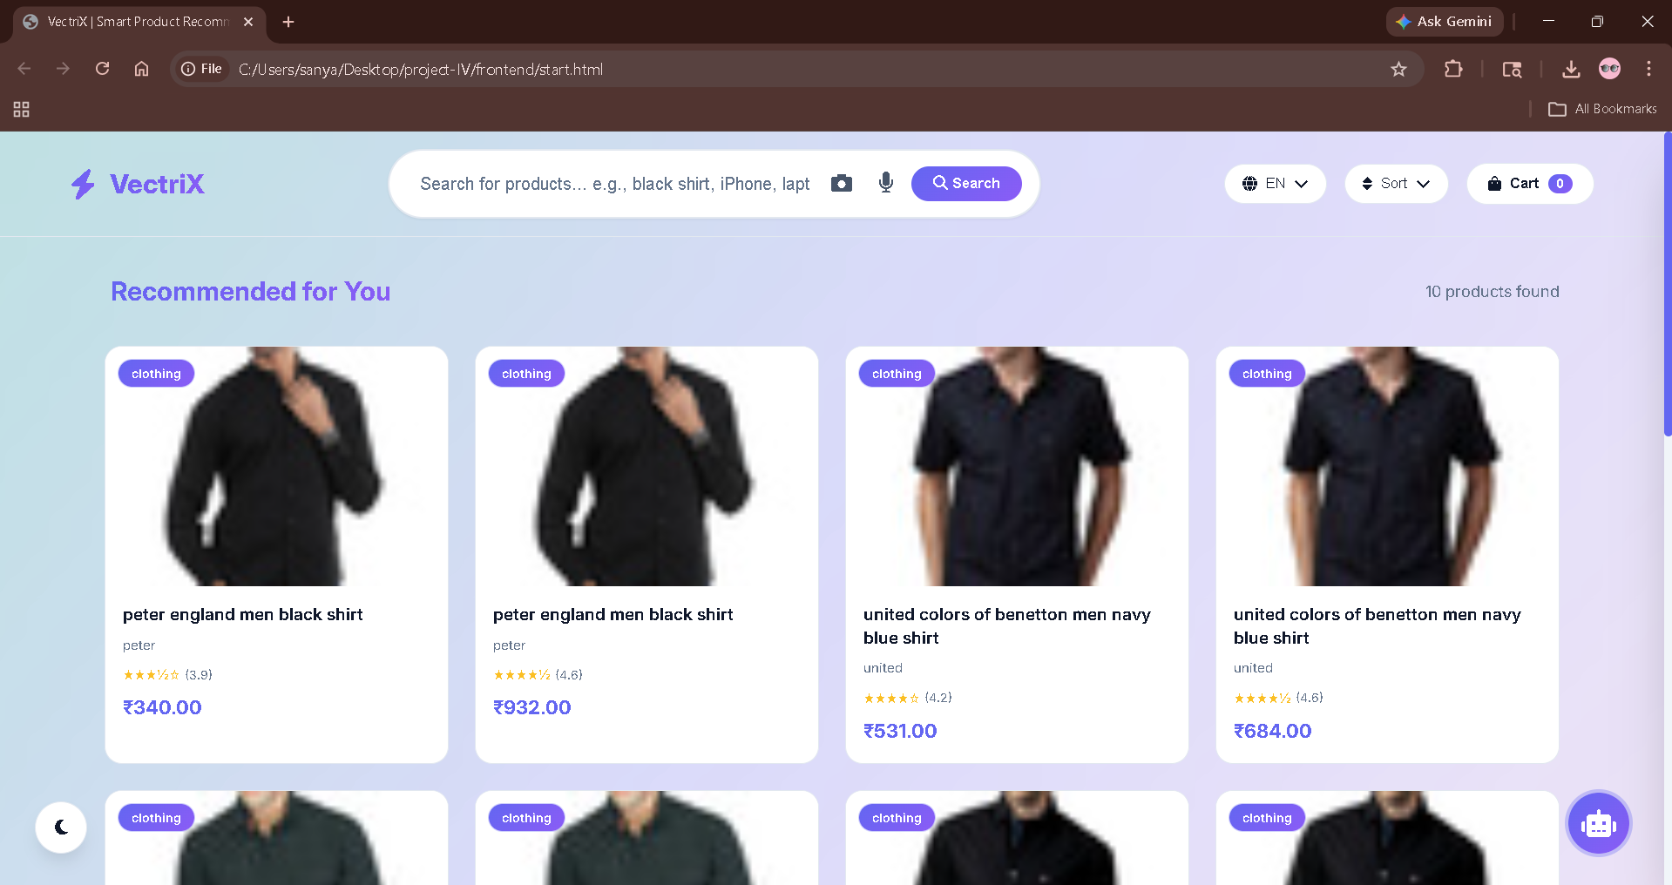
RESULTS - TEXT & IMAGE SEARCH
Text Search
Image Search
Query "red shoes for men" returns semantically relevant red footwear (not just exact "red").
Uploading a Black shirt image returns visually similar shirts based on shape/color.

Slide 22
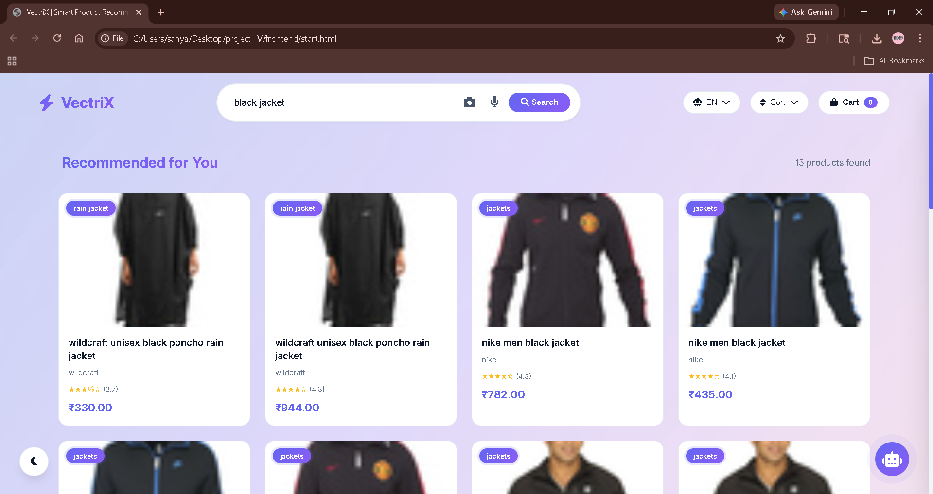
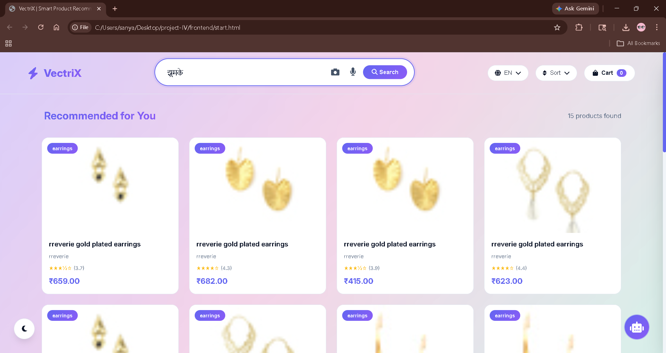
RESULTS - MULTILINGUAL & VOICE
Voice
Multilingual
Click mic -> Speak "black jacket" -> Text fills -> Search executes.
Input "झुमके" (Hindi) -> Detected -> Translated -> Returns earrings.

Slide 23
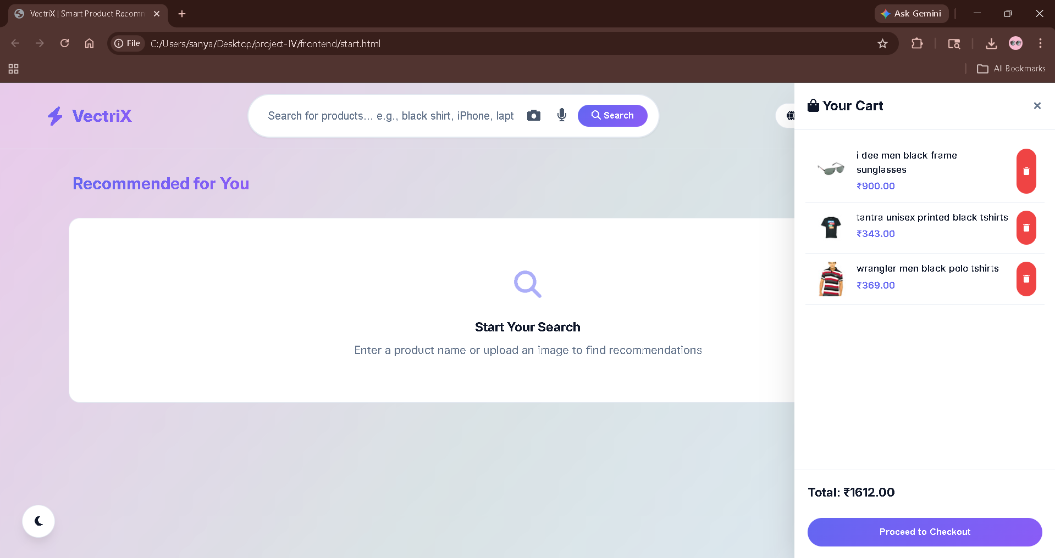
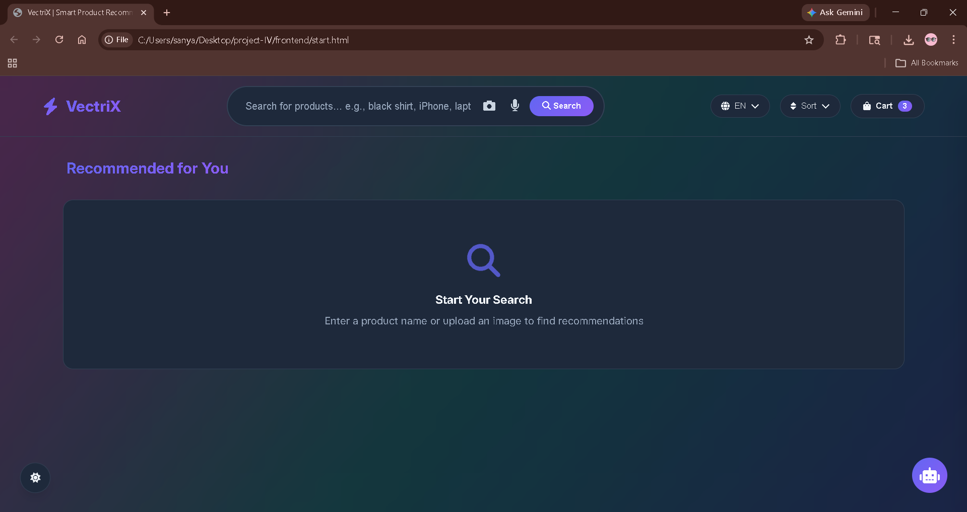
RESULTS - UI FEATURES
The Shopping Cart and Dark Mode features significantly enhance the user experience by prioritizing functionality and comfort.

Slide 24
RESULTS - CHATBOT (RAG)
Function: Integrated shopping assistant.
Query: "What should I check before buying a laptop?"
Process: FAISS retrieves laptop products -> LLM generates context-aware buying advice.
Outcome: Factual, helpful responses (not generic AI).

Slide 25
DISCUSSION OF RESULTS
Strengths:
Semantic understanding significantly outperforms keyword search.
FAISS enables real-time retrieval (<2 seconds).
Multimodal input (text/image/voice) provides flexibility.
Challenges:
Image retrieval accuracy varies with image quality.
Precision drops for ambiguous queries (e.g., "black jacket").

Slide 26
CONCLUSION
Successfully built a Multimodal AI E-commerce Search System.
Integrated NLP, CV, FAISS, and LLM into a unified architecture.
Achieved high Precision@K (up to 1.0) using hybrid retrieval.
Enabled explainable AI via RAG-based LLM explanations.
Provided a production-ready UI with modern features (dark mode, voice, multilingual).

Slide 27
LIMITATIONS OF THE SYSTEM
Dataset Dependency: Performance tied to data quality.
LLM Capacity: Phi-3 is lightweight; less detailed than larger models.
No Personalization: Does not use user history or preferences.
Scalability: FAISS is efficient but distributed databases (Milvus) would be better for billion-scale.

Slide 28
FUTURE SCOPE
Advanced LLMs: Integrate LLaMA 3 / GPT-4o for deeper reasoning.
Real-time Recommendations: Add collaborative filtering for personalization.
Vector Databases: Migrate to Pinecone/Milvus for cloud scaling.
Multimodal Models: Use Gemini-style models for joint text-image understanding.
Mobile App: Deploy as React Native app with camera search.

Slide 29
KEY ACHIEVEMENTS (RECAP)
Dataset Engineering: Merged 5+ datasets into a unified schema.
Optimization: Reduced embedding time from 5 hours (CPU) to minutes (GPU).
Hybrid Algorithm: Developed custom ranking combining semantic + keyword scores.
LLM Optimization: Solved hallucination via prompt engineering and RAG.

Slide 30
REFERENCES
Reimers & Gurevych (2019). Sentence-BERT. EMNLP.
Radford et al. (2021). CLIP. ICML.
Johnson et al. (2017). FAISS. Facebook AI Research.
Rusum & Anasuri (2024). Vector Databases in Modern Applications.
Ali, O. (2025). Retrieval-Augmented Generation. JIIS.
Vaswani et al. (2017). Attention Is All You Need. NeurIPS.

Slide 31

THANK YOU
Project Guide: Ms.V. KIRUTHIGA MCA., M.Phil., Ph.D.
Student: MANGIPUDI SANYASI RAO (TU6243204211024)
School: Computer Science, Takshashila University

